Slide 1

CSE 473: Pattern Recognition

Slide 2
Context Dependent Classification

Slide 3
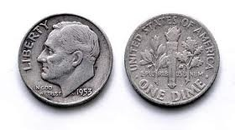
Hidden Markov Model

Slide 4
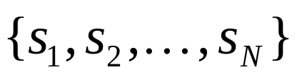
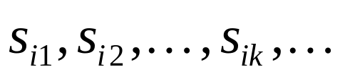
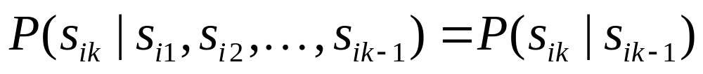
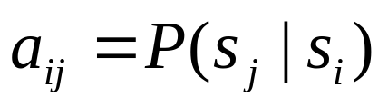
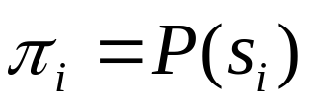
Markov Models
Set of states:
Process moves from one state to another generating a sequence of states :
Markov chain property: probability of each subsequent state depends only on what was the previous state:
To define Markov model, the following probabilities have to be specified: transition probabilities and initial probabilities

Slide 5
Example of Markov Model
0.3
0.7
Rain
Dry
0.2
0.8
Two states : ‘Rain’ and ‘Dry’.
Transition probabilities:
  P(‘Rain’|‘Rain’)=0.3 , P(‘Dry’|‘Rain’)=0.7 ,
  P(‘Rain’|‘Dry’)=0.2, P(‘Dry’|‘Dry’)=0.8
Initial probabilities: say P(‘Rain’)=0.4 , P(‘Dry’)=0.6 .

Slide 6
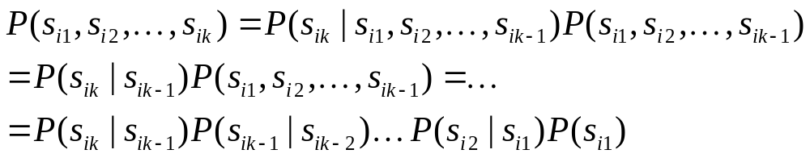
Calculation of sequence probability
By Markov chain property, probability of state sequence can be found by the formula:

Slide 7
Calculation of sequence probability
0.3
0.7
Rain
Dry
0.2
0.8
Suppose we want to calculate a probability of a sequence of states in our example, {‘Dry’,’Dry’,’Rain’,Rain’}.
P({‘Dry’,’Dry’,’Rain’,Rain’} )

Slide 8
Calculation of sequence probability
0.3
0.7
Rain
Dry
0.2
0.8
Suppose we want to calculate a probability of a sequence of states in our example, {‘Dry’,’Dry’,’Rain’,Rain’}.
P({‘Dry’,’Dry’,’Rain’,Rain’} )
= P(‘Rain’|’Rain’) P(‘Rain’|’Dry’) P(‘Dry’|’Dry’) P(‘Dry’)

Slide 9
Calculation of sequence probability
0.3
0.7
Rain
Dry
0.2
0.8
Suppose we want to calculate a probability of a sequence of states in our example, {‘Dry’,’Dry’,’Rain’,Rain’}.
P({‘Dry’,’Dry’,’Rain’,Rain’} )
= P(‘Rain’|’Rain’) P(‘Rain’|’Dry’) P(‘Dry’|’Dry’) P(‘Dry’)
= 0.3*0.2*0.8*0.6

Slide 10
Hidden Markov Model

Slide 11
Hidden Markov Model

Slide 12
Hidden Markov Model
H T H H T T T H H H . . . . .

Slide 13
Hidden Markov Model
H T H H T T T H H H . . . . .
Can we guess which coin is tossed at what time?

Slide 14
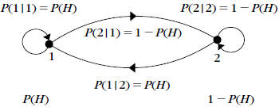
Not A Hidden Markov Model

Slide 15
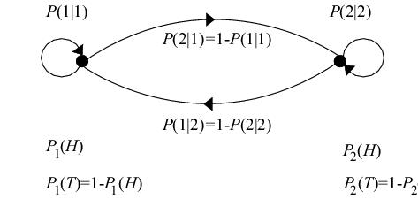
Hidden Markov Model

Slide 16
Hidden Markov models
Set of states:
Process moves from one state to another generating a sequence of states :
Markov chain property: probability of each subsequent state depends only on what was the previous state:

Slide 17
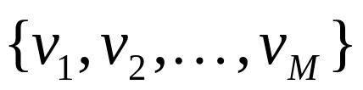
Hidden Markov models
States are not visible, but each state randomly generates one of M observations (or visible states)
To define hidden Markov model, the following probabilities have to be specified:
  matrix of transition probabilities A=(a_{ij}), a_{ij}= P(s_{j} | s_{i})
  matrix of observation probabilities B=(b_{i} (v_{m} )),
  where, b_{i}(v_{m} ) =P(v_{m}|s_{i})
  vector of initial probabilities π=(π_{i}), π_{i} = P(s_{i})
Model is represented by M=(A, B, π).

Slide 18
Example of Hidden Markov Model
0.3
0.7
Low
High
0.2
0.8
0.6
0.6
0.4
0.4
Rain
Dry

Slide 19
Example of Hidden Markov Model
0.3
0.7
Low
High
0.2
0.8
0.6
0.6
0.4
0.4
Rain
Dry
Initial probabilities: say P(‘Low’)=0.4 , P(‘High’)=0.6 .

Slide 20
Example of Hidden Markov Model
Two states : ‘Low’ and ‘High’ atmospheric pressure.
Two observations : ‘Rain’ and ‘Dry’.
Transition probabilities: P(‘Low’|‘Low’)=0.3 , P(‘High’|‘Low’)=0.7 , P(‘Low’|‘High’)=0.2, P(‘High’|‘High’)=0.8
Observation probabilities : P(‘Rain’|‘Low’)=0.6 , P(‘Dry’|‘Low’)=0.4 , P(‘Rain’|‘High’)=0.4 , P(‘Dry’|‘High’)=0.3 .
Initial probabilities: say P(‘Low’)=0.4 , P(‘High’)=0.6 .

Slide 21
Calculation of observation sequence probability
Suppose we want to calculate a probability of a sequence of observations in our example, {‘Dry’,’Rain’}.
Consider all possible hidden state sequences:
P({‘Dry’,’Rain’} ) = P({‘Dry’,’Rain’} , {‘Low’,’Low’})
+P({‘Dry’,’Rain’} , {‘Low’,’High’})
+ P({‘Dry’,’Rain’} , {‘High’,’Low’})
+ P({‘Dry’,’Rain’} , {‘High’,’High’})

Slide 22
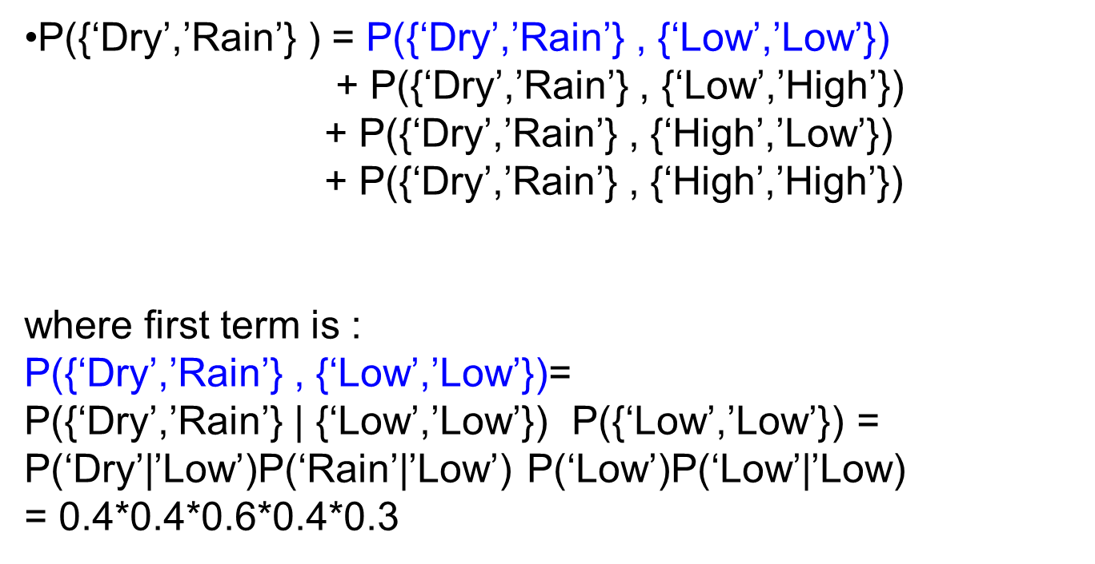
Calculation of observation sequence probability

Slide 23
Main issues using HMMs
Evaluation problem.
Given the HMM M=(A, B, π) and the observation sequence O=o₁ o₂ ... o_{K} , calculate the probability that model M has generated sequence O .
O=o₁...o_{K} denotes a sequence of observations o_{k}∈{v₁,…,v_{M}}.

Slide 24
Main issues using HMMs
Decoding problem.
Given the HMM M=(A, B, π) and the observation sequence O=o₁ o₂ ... o_{K} , calculate the most likely sequence of hidden states s_{i} that produced this observation sequence O.
O=o₁...o_{K} denotes a sequence of observations o_{k}∈{v₁,…,v_{M}}.

Slide 25
Main issues using HMMs
Learning problem.
Given some training observation sequences O=o₁ o₂ ... o_{K} and general structure of HMM (numbers of hidden and visible states), determine HMM parameters M=(A, B, π) that best fit training data.
O=o₁...o_{K} denotes a sequence of observations o_{k}∈{v₁,…,v_{M}}.

Slide 26
The evaluation Problem
Given the HMM M=(A, B, π) and the observation sequence O=o₁ o₂ ... o_{K} , calculate the probability that model M has generated sequence O.
where, O=o₁...o_{K} denotes a sequence of observations o_{k}∈{v₁,…,v_{M}}.

Slide 27
The evaluation Problem
Given the HMM M=(A, B, π) and the observation sequence O=o₁ o₂ ... o_{K} , calculate the probability that model M has generated sequence O.
where, O=o₁...o_{K} denotes a sequence of observations o_{k}∈{v₁,…,v_{M}}.
Alternately, find P(O|M) or P(o₁ o₂ ... o_{K}|M)

Slide 28
The evaluation Problem
Given the HMM M=(A, B, π) and the observation sequence O=o₁ o₂ ... o_{K} , calculate the probability that model M has generated sequence O.
where, O=o₁...o_{K} denotes a sequence of observations o_{k}∈{v₁,…,v_{M}}.
Alternately, find P(O|M) or P(o₁ o₂ ... o_{K}|M)
For simplicity we write it as P(O) or P(o₁ o₂ ... o_{K})

Slide 29
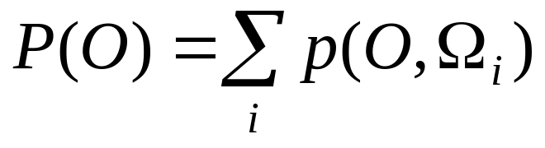
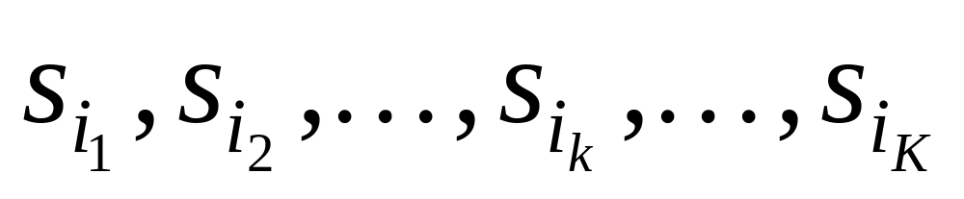
The evaluation Problem
Objective:
find P(O) or P(o₁ o₂ ... o_{K})
where, Ω_{i} is a possible state sequence

Slide 30
The evaluation Problem
Objective:
find P(O) or P(o₁ o₂ ... o_{K})
where, Ω_{i} is a possible state sequence
There are N^{K} possible state sequences!!

Slide 31
The evaluation Problem
Objective:
find P(O) or P(o₁ o₂ ... o_{K})
where, Ω_{i} is a possible state sequence
Complexity is O(N^{K} )

Slide 32
Alternate Solution to The evaluation Problem
Use Forward-Backward HMM algorithms for efficient calculations.
Define the forward variable α_{k}(i) as the joint probability of
  the partial observation sequence o₁ o₂ ... o_{k} and
  the hidden state at time k is s_{i} :
α_{k}(i)= P(o_{1,} o₂ ... o_{k ,} q_{k}= s_{i} )

Slide 33
Trellis representation of an HMM
o₁ o_{k} o_{k+1} o_{K} = Observations
s₁
s₁
s₁
s₁
s₂
s₂
a_{1j}
s₂
s₂
a_{2j}
s_{i}
s_{i}
a_{ij}
s_{i}
s_{j}
a_{Nj}
s_{N}
s_{N}
s_{N}
s_{N}
Time= 1 k k+1 K

Slide 34
Trellis representation of an HMM
o₁ o_{k} o_{k+1} o_{K} = Observations
s₁
α_{k}(1)
s₁
s₁
s₂
α_{k}(2)
a_{1j}
s₂
s₂
a_{2j}
s_{i}
α_{k}(i)
s_{i}
a_{ij}
s_{j}
a_{Nj}
s_{N}
α_{k}(N)
s_{N}
s_{N}
Time= 1 k k+1 K

Slide 35
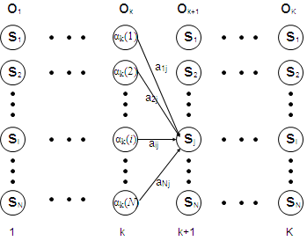
Trellis representation of an HMM
Therefore, we can write,
α_{k+1}(j)= P(o₁ o₂ ... o_{k+1 ,} q_{k+1}= s_{j} )
=Σ_{i} P(o₁ o₂ ... o_{k+1 ,}q_{k}= s_{i ,} q_{k+1}=s_{j})
=Σ_{i} P(o₁ o₂ ...o_{k ,} q_{k}= s_{i}) a_{ij} b_{j} (o_{k+1} )
=[Σ_{i} α_{k}(i) a_{ij} ] b_{j} (o_{k+1} ) ,
for 1<=j<=N, 1<=k<=K-1.

Slide 36
Trellis representation of an HMM
Now P(o₁ o₂ ... o_{K})
can be written as Σ_{i} P(o₁ o₂ ... o_{K ,} q_{K}= s_{i}) = Σ_{i} α_{K}(i)

Slide 37
Forward recursion for HMM
Initialization:
α₁(i)= P(o_{1 ,} q₁= s_{i} ) = π_{i} b_{i} (o₁) , 1<=i<=N.
Forward recursion:
α_{k+1}(j) = [Σ_{i} α_{k}(i) a_{ij} ] b_{j} (o_{k+1} ) , 1<=j<=N, 1<=k<=K-1.
Termination:
P(o₁ o₂ ... o_{K}) = Σ_{i} α_{K}(i)

Slide 38
Forward recursion for HMM
Initialization:
α₁(i)= P(o_{1 ,} q₁= s_{i} ) = π_{i} b_{i} (o₁) , 1<=i<=N.
Forward recursion:
α_{k+1}(j) = [Σ_{i} α_{k}(i) a_{ij} ] b_{j} (o_{k+1} ) , 1<=j<=N, 1<=k<=K-1.
Termination:
P(o₁ o₂ ... o_{K}) = Σ_{i} α_{K}(i)
Complexity :
N²K operations.

Slide 39
Backward recursion for HMM
Define the backward variable β_{k}(j) as the probability of
  the partial observation sequence o_{k+1} o_{k+2} ... o_{K}
  given that the hidden state at time k is s_{j} :
  β_{k}(j)= P(o_{k+1} o_{k+2} ... o_{K} |q_{k}= s_{j} )

Slide 40
Backward recursion for HMM
Define β_{k}(j) in terms of β_{k+1}(i)’s: the probability of
  the partial observation sequence o_{k+2} o_{k+3} ... o_{K}
  given that the hidden state at time k+1 is s_{i} :
  β_{k+1}(i)= P(o_{k+2} o_{k+3} ... o_{K} |q_{k+1}= s_{i} )

Slide 41
Backward recursion for HMM
Define β_{k}(j) in terms of β_{k+1}(i)’s: the probability of
where β_{k+1}(i)= P(o_{k+2} o_{k+3} ... o_{K} |q_{k+1}= s_{i} )
Now,
β_{k}(j)= P(o_{k+1} o_{k+2} ... o_{K} | q_{k}= s_{j} )
= Σ_{i} P(o_{k+1} o_{k+2} ... o_{K ,} q_{k+1}= s_{i} | q_{k}= s_{j} )
= Σ_{i} P(o_{k+2} o_{k+3} ... o_{K} | q_{k+1}= s_{i}) a_{ji} b_{i} (o_{k+1} )
= Σ_{i} β_{k+1}(i) a_{ji} b_{i} (o_{k+1} ) , 1<=j<=N, 1<=k<=K-1.

Slide 42
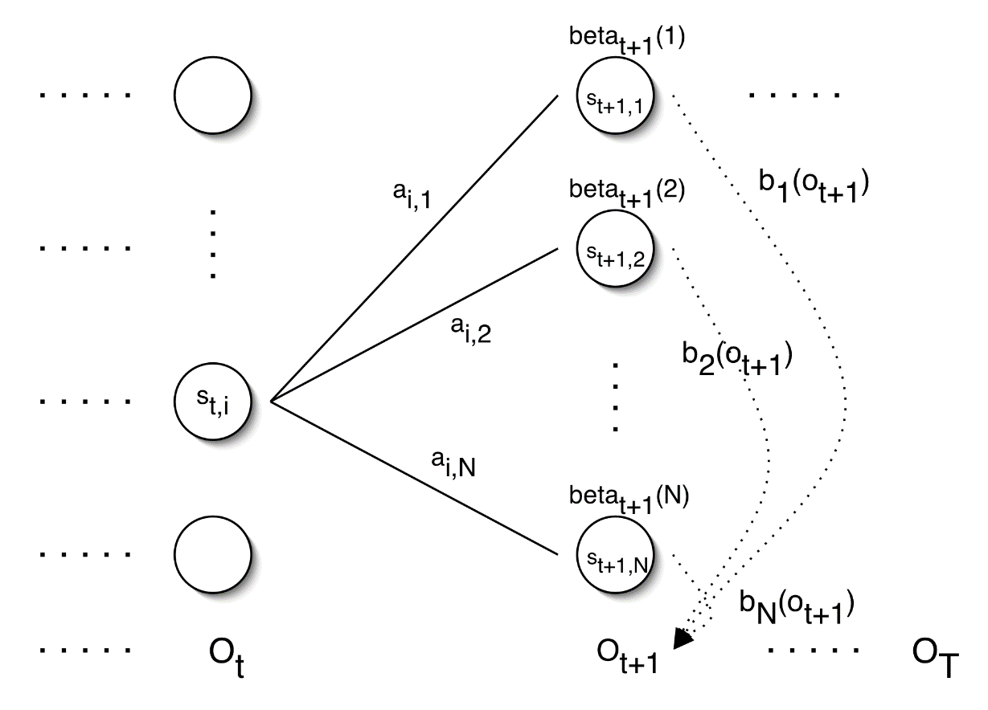
Backward recursion for HMM
= Σ_{i} P(o_{k+1} o_{k+2} ... o_{K ,} q_{k+1}= s_{i} | q_{k}= s_{j} )
= Σ_{i} P(o_{k+2} o_{k+3} ... o_{K} | q_{k+1}= s_{i}) a_{ji} b_{i} (o_{k+1} )
= Σ_{i} β_{k+1}(i) a_{ji} b_{i} (o_{k+1} ) , 1<=j<=N, 1<=k<=K-1.
β_{k+1}(1)
b₁(O_{k+1})
β_{k+1}(2)
b₂(O_{k+1})
β_{k}(j)
β_{k+1}(N)
b_{N}(O_{k+1})
o_{k}
O_{k+1}
o_{K}

Slide 43
Backward recursion for HMM
Initialization:
β_{K}(i)= 1 , 1<=i<=N.
Backward recursion:
β_{k}(j)= Σ_{i} β_{k+1}(i) a_{ji} b_{i} (o_{k+1} ) , 1<=j<=N, 1<=k<=K-1.
Termination:
P(o₁ o₂ ... o_{K}) = Σ_{i} P(o₁ o₂ ... o_{K ,} q₁= s_{i}) =
Σ_{i} P(o₁ o₂ ... o_{K} |q₁= s_{i}) P(q₁= s_{i}) = Σ_{i} β₁(i) b_{i} (o₁) π_{I}

Slide 44
Main issues using HMMs (2)
Decoding problem.
Given the HMM M=(A, B, π) and the observation sequence O=o₁ o₂ ... o_{K} , calculate the most likely sequence of hidden states s_{i} that produced this observation sequence O.
O=o₁...o_{K} denotes a sequence of observations o_{k}∈{v₁,…,v_{M}}.

Slide 45
Decoding problem
Given the HMM M=(A, B, π) and the observation sequence O=o₁ o₂ ... o_{K} , calculate the most likely sequence of hidden states s_{i} that produced this observation sequence O.
We want to find:
the state sequence Q= q₁…q_{K} maximizing
P(Q | o₁ o₂ ... o_{K} ) , or equivalently
P(Q , o₁ o₂ ... o_{K} )

Slide 46
Decoding problem
Find max value of P(Q , o₁ o₂ ... o_{K} )
Brute Force Method:
Try for all possible sequences of states
N^{K} possible sequences for Q

Slide 47
Decoding problem
Use efficient Viterbi algorithm instead
Define variable δ_{k}(i) as the maximum probability of
  producing observation sequence o₁ o₂ ... o_{k}
  when moving along any hidden state sequence q₁… q_{k-1} and
  getting into q_{k}= s_{i}

Slide 48
Decoding problem
Use efficient Viterbi algorithm instead
Define variable δ_{k}(i) as the maximum probability of
  producing observation sequence o₁ o₂ ... o_{k}
  when moving along any hidden state sequence q₁… q_{k-1} and
  getting into q_{k}= s_{i}
Therefore, δ_{k}(i) = max P(q₁… q_{k-1} , q_{k}= s_{i} , o₁ o₂ ... o_{k})
where max is taken over all possible paths q₁… q_{k-1} .

Slide 49
Decoding problem
General idea:
if best path ending in q_{k}= s_{j} goes through q_{k-1}= s_{i} then it should coincide with best path ending in q_{k-1}= s_{i} .
q_{k-1} q_{k}
s₁
a_{1j}
s_{i}
s_{j}
a_{ij}
s_{N}
a_{Nj}

Slide 50
Decoding problem
General idea:
if best path ending in q_{k}= s_{j} goes through q_{k-1}= s_{i} then it should coincide with best path ending in q_{k-1}= s_{i} .
q_{k-1} q_{k}
s₁
a_{1j}
s_{i}
s_{j}
a_{ij}
s_{N}
a_{Nj}
δ_{k}(j) = max P(q₁… q_{k-1} , q_{k}= s_{j} , o₁ o₂ ... o_{k})

Slide 51
Decoding problem
General idea:
if best path ending in q_{k}= s_{j} goes through q_{k-1}= s_{i} then it should coincide with best path ending in q_{k-1}= s_{i} .
q_{k-1} q_{k}
s₁
a_{1j}
s_{i}
s_{j}
a_{ij}
s_{N}
a_{Nj}
δ_{k}(j) = max P(q₁… q_{k-1} , q_{k}= s_{j} , o₁ o₂ ... o_{k})
= max_{i} [ a_{ij} b_{j} (o_{k} ) max P(q₁… q_{k-1}= s_{i} , o₁ o₂ ... o_{k-1}) ]

Slide 52
Decoding problem
General idea:
if best path ending in q_{k}= s_{j} goes through q_{k-1}= s_{i} then it should coincide with best path ending in q_{k-1}= s_{i} .
q_{k-1} q_{k}
s₁
a_{1j}
s_{i}
s_{j}
a_{ij}
s_{N}
a_{Nj}
δ_{k}(j) = max P(q₁… q_{k-1} , q_{k}= s_{j} , o₁ o₂ ... o_{k})
= max_{i} [ a_{ij} b_{j} (o_{k} ) max P(q₁… q_{k-1}= s_{i} , o₁ o₂ ... o_{k-1}) ]
= max_{i} [ a_{ij} b_{j} (o_{k} ) δ_{k-1}(i)]

Slide 53
Decoding problem
General idea:
if best path ending in q_{k}= s_{j} goes through q_{k-1}= s_{i} then it should coincide with best path ending in q_{k-1}= s_{i} .
q_{k-1} q_{k}
s₁
a_{1j}
s_{i}
s_{j}
a_{ij}
s_{N}
a_{Nj}
To backtrack best path keep info that predecessor of s_{j} was s_{i}.

Slide 54
Decoding problem
Initialization:
δ₁(i) = max P(q₁= s_{i} , o₁) = π_{i} b_{i} (o₁) , 1<=i<=N
Forward recursion:
δ_{k}(j) = max_{i} [ a_{ij} b_{j} (o_{k} ) δ_{k-1}(i) ] , 1<=j<=N, 2<=k<=K.
Termination: choose best path ending at time K
max_{i} [ δ_{K}(i) ]
Backtrack best path.

Slide 55
Issues in HMMs (3)
Learning/Training problem.
Given some training observation sequences O=o₁ o₂ ... o_{K} and general structure of HMM (numbers of hidden and visible states), determine HMM parameters M=(A, B, π) that best fit training data.
O=o₁...o_{K} denotes a sequence of observations o_{k}∈{v₁,…,v_{M}}.

Slide 56
Learning/Training Problem
Given some training observation sequences O=o₁ o₂ ... o_{K} and general structure of HMM (numbers of hidden and visible states), determine HMM parameters M=(A, B, π) that best fit training data.
There is no algorithm producing optimal parameter values.

Slide 57
Learning/Training Problem
Given some training observation sequences O=o₁ o₂ ... o_{K} and general structure of HMM (numbers of hidden and visible states), determine HMM parameters M=(A, B, π) that best fit training data.
There is no algorithm producing optimal parameter values.
Use iterative Expectation-Maximization (EM) algorithm to find local maximum of P(O | M) - Baum-Welch algorithm.

Slide 58
Learning/Training Problem
Idea of EM :
Initialization: Assume initial value of A, B, π
and calculate P(O | M)
E-step:
Estimate new values of the model parameters: A, B, π
from the previous values of A, B, π
M-step:
Find P(O | M) with the new values of A, B, π
Repeat these steps until P(O | M) declines

Slide 59
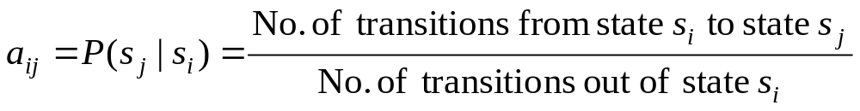
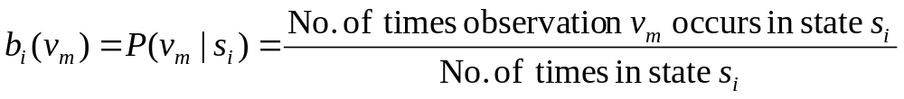
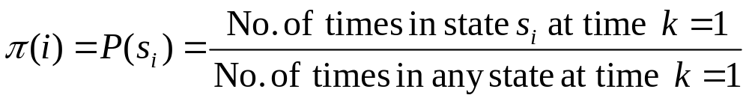
Learning/Training Problem
we need to calculate the following parameters:

Slide 60
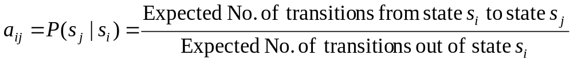
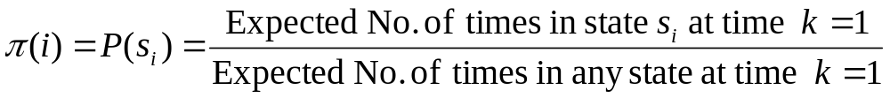
Baum-Welch algorithm
the algorithm estimates the expected value::

Slide 61
Baum-Welch algorithm
Define variable ξ_{k}(i,j) as the probability of being in state s_{i} at time k and in state s_{j} at time k+1, given the observation sequence o₁ o₂ ... o_{K} .
ξ_{k}(i,j)= P(q_{k}= s_{i} , q_{k+1}= s_{j} | o₁ o₂ ... o_{K})

Slide 62
Baum-Welch algorithm
Define variable ξ_{k}(i,j) as the probability of being in state s_{i} at time k and in state s_{j} at time k+1, given the observation sequence o₁ o₂ ... o_{K} .
ξ_{k}(i,j)= P(q_{k}= s_{i} , q_{k+1}= s_{j} | o₁ o₂ ... o_{K})
P(q_{k}= s_{i} , q_{k+1}= s_{j} , o₁ o₂ ... o_{K})
P(o₁ o₂ ... o_{k})
ξ_{k}(i,j)=

Slide 63
Baum-Welch algorithm
Define variable ξ_{k}(i,j) as the probability of being in state s_{i} at time k and in state s_{j} at time k+1, given the observation sequence o₁ o₂ ... o_{K} .
ξ_{k}(i,j)= P(q_{k}= s_{i} , q_{k+1}= s_{j} | o₁ o₂ ... o_{K})
P(q_{k}= s_{i} , q_{k+1}= s_{j} , o₁ o₂ ... o_{K})
P(o₁ o₂ ... o_{k})
ξ_{k}(i,j)=
P(q_{k}= s_{i} , o₁ o₂ ... o_{k}) a_{ij} b_{j} (o_{k+1} ) P(o_{k+2} ... o_{K} | q_{k+1}= s_{j} )
P(o₁ o₂ ... o_{k})
=

Slide 64
Baum-Welch algorithm
Define variable ξ_{k}(i,j) as the probability of being in state s_{i} at time k and in state s_{j} at time k+1, given the observation sequence o₁ o₂ ... o_{K} .
ξ_{k}(i,j)= P(q_{k}= s_{i} , q_{k+1}= s_{j} | o₁ o₂ ... o_{K})
P(q_{k}= s_{i} , o₁ o₂ ... o_{k}) a_{ij} b_{j} (o_{k+1} ) P(o_{k+2} ... o_{K} | q_{k+1}= s_{j} )
P(o₁ o₂ ... o_{k})
=
α_{k}(i) a_{ij} b_{j} (o_{k+1} ) β_{k+1}(j)
P(o₁ o₂ ... o_{k})
=

Slide 65
Baum-Welch algorithm
Define variable γ_{k}(i) as the probability of being in state s_{i} at time k, given the observation sequence o₁ o₂ ... o_{K} .
γ_{k}(i)= P(q_{k}= s_{i} | o₁ o₂ ... o_{K})
P(q_{k}= s_{i} , o₁ o₂ ... o_{k})
P(o₁ o₂ ... o_{k})
α_{k}(i) β_{k}(i)
P(o₁ o₂ ... o_{k})
γ_{k}(i)=
=

Slide 66
Baum-Welch algorithm
We calculated ξ_{k}(i,j) = P(q_{k}= s_{i} , q_{k+1}= s_{j} | o₁ o₂ ... o_{K})
and γ_{k}(i)= P(q_{k}= s_{i} | o₁ o₂ ... o_{K})
Expected number of transitions from state s_{i} to state s_{j}
= Σ_{k} ξ_{k}(i,j)
Expected number of transitions out of state s_{i} = Σ_{k} γ_{k}(i)
Expected number of times observation v_{m} occurs in state s_{i} =
= Σ_{k} γ_{k}(i) , k is such that o_{k}= v_{m}

Slide 67
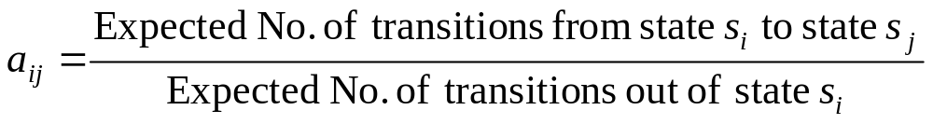
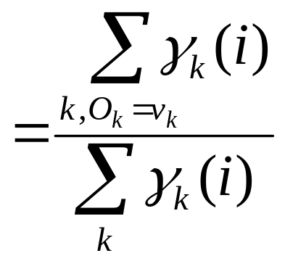
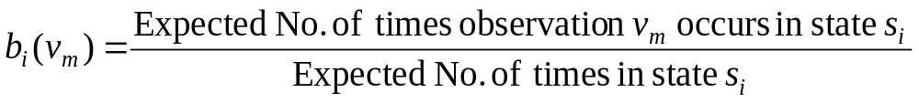
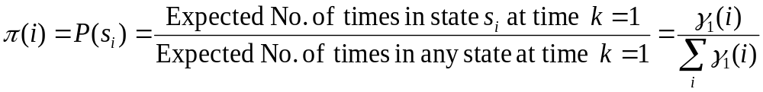
Baum-Welch algorithm: E-Step
Estimate the expected values as
Σ_{k} ξ_{k}(i,j)
Σ_{k} γ_{k}(i)
=

Slide 68
Baum-Welch algorithm: E-Step
Estimate the expected values as
Σ_{k} ξ_{k}(i,j)
Σ_{k} γ_{k}(i)
=

Slide 69
Learning/Training Algorithm
Initialization: Assume initial value of A, B, π
and calculate P(O | M)
E-step:
Estimate new values of the model parameters: A, B, π
from the previous values of A, B, π
M-step:
Find P(O | M) with the new values of A, B, π
Repeat these steps until P(O | M) declines

